Slide 1

MySQL installation
Isuru Sri Bandara
isuru.s@nsbm.ac.lk

Slide 2

XAMMP
XAMPP stands for Cross-Platform (X) Apache (A) MySQL (M), PHP (P) Perl (P).
Pros | Cons
completely free | XAMPP is difficult to configure as compared to WAMP Server.
Simple
Open Source
Easy to use
Easy to Install

Slide 3
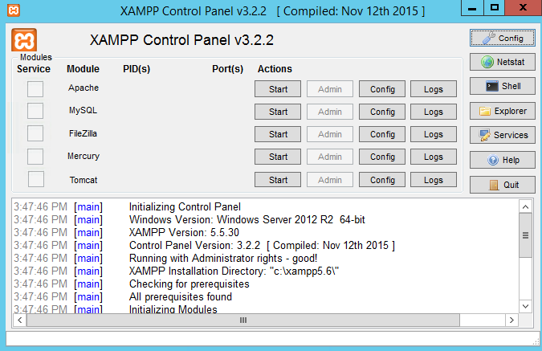

Controller View

Slide 4
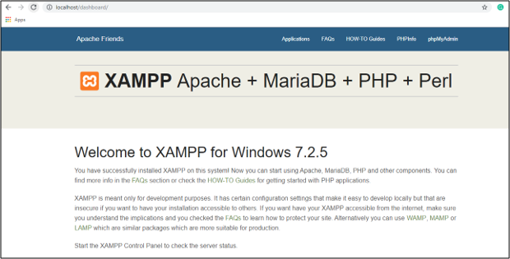
Web View

Slide 5
Alternatives to XAMMP
WampServer
EASYPHP
AMPPS
Desktop Server
ERBuilder
MAMP
Laragon
Apache HTTP Server
Zend Framework
UwAmp Server

Slide 6
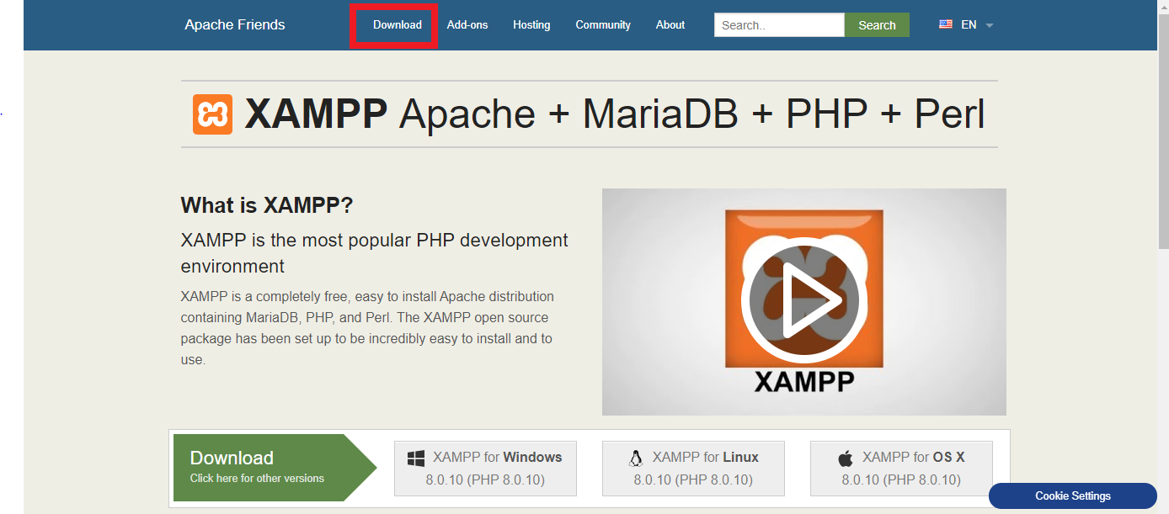
Installation
1st Step
https://www.apachefriends.org/index.html

Slide 7
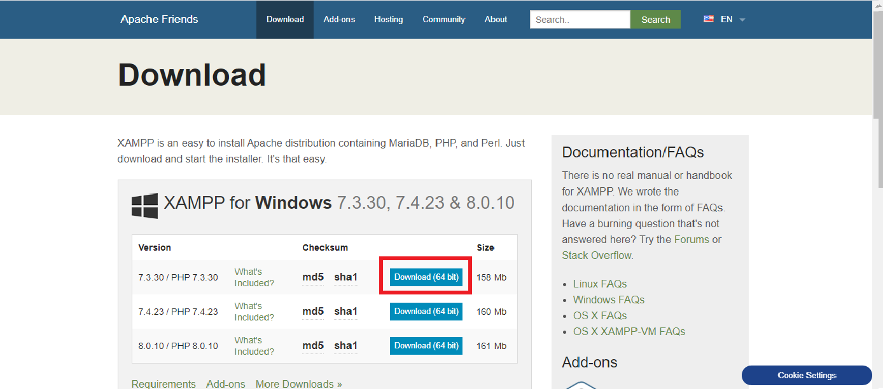
Installation
^{2nd Step}
https://www.apachefriends.org/download.html

Slide 8
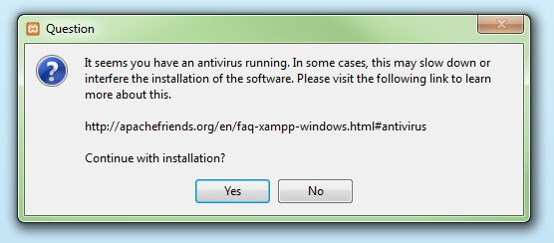
Installation
^{3rd Step}
Run Downloaded File

Slide 9
Installation
^{4th Step}
Click on “Yes”
This occurs to disable virus guard

Slide 10
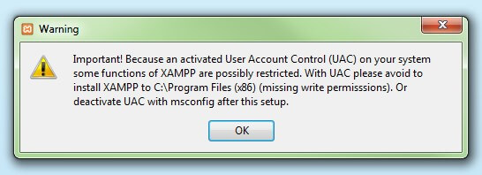
Installation
^{5th Step}
Click on “OK”
This occurs due to User Account Control(UAC) Regulation

Slide 11
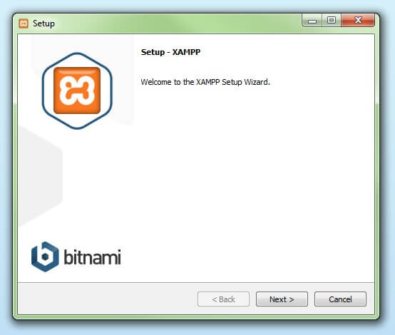
Installation
^{6th Step}
Click on “Next”
To Continue Setup

Slide 12
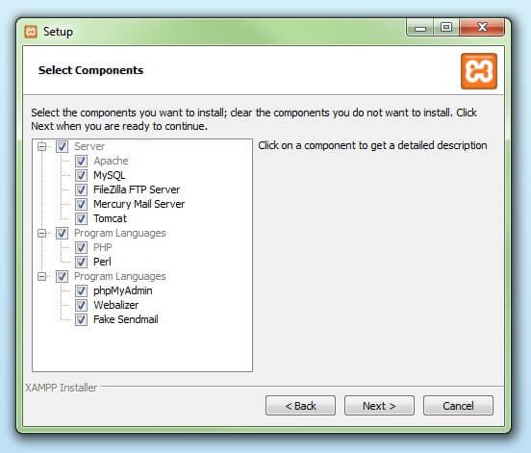
Installation
^{7th Step}
Click on “Next” after selecting services that you need

Slide 13
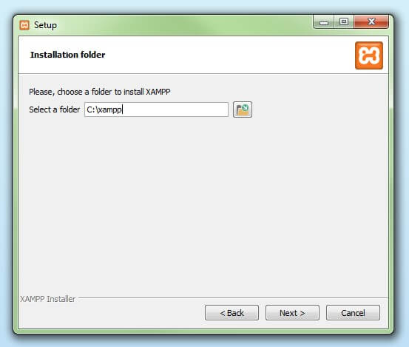
Installation
^{8th Step}
Click on “Next” after selecting installation path & it is better to keep default location

Slide 14
Installation
^{9th Step}
Click on “Next” after selecting installation path & it is better to keep default location

Slide 15
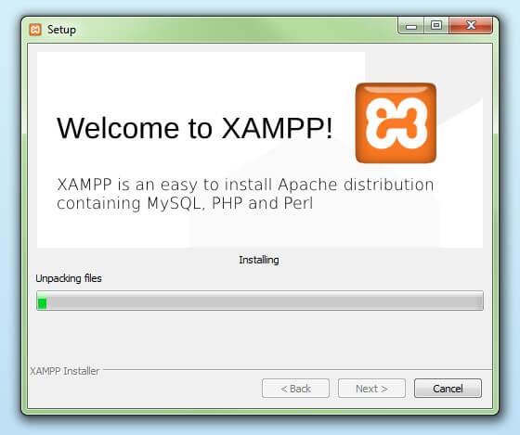
Installation
^{10th Step}
Wait until installation complete

Slide 16
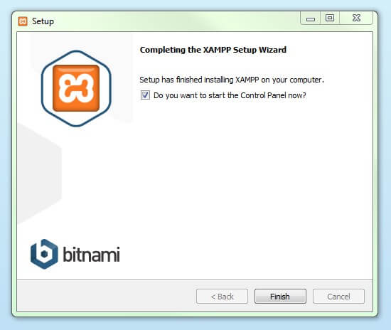
Installation
^{11th Step}
Click on Finish button

Slide 17
How to access MySQL
There are main 3 ways to access to the MySQL
^{By visiting to the Location}
^{By using Command prompt}
^{Via Xampp}
NOTE : Default username : root & no password

Slide 18
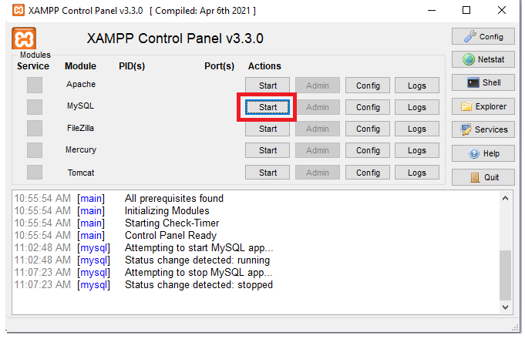
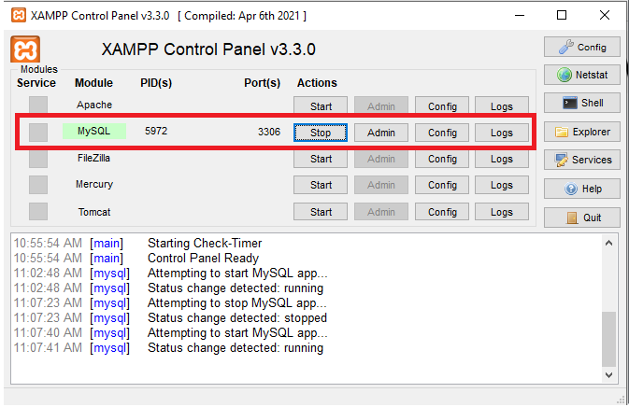
How to access MySQL
^{Run the Xammp Database Service}
Before
After

Slide 19
How to access MySQL
^{1st method}
^{By Visiting to the location}
Default Installation location is : C:\xampp\mysql\bin
^{Visit to this location}
File → Open Power shell / Command Prompt
^{Run below Code to access MySQL}
Power Shell :- .\mysql -h localhost -u root –p
Command Prompt :- mysql -h localhost -u root –p
^{Command Format identification}
mysql –h hostname –u username –p [password]

Slide 20
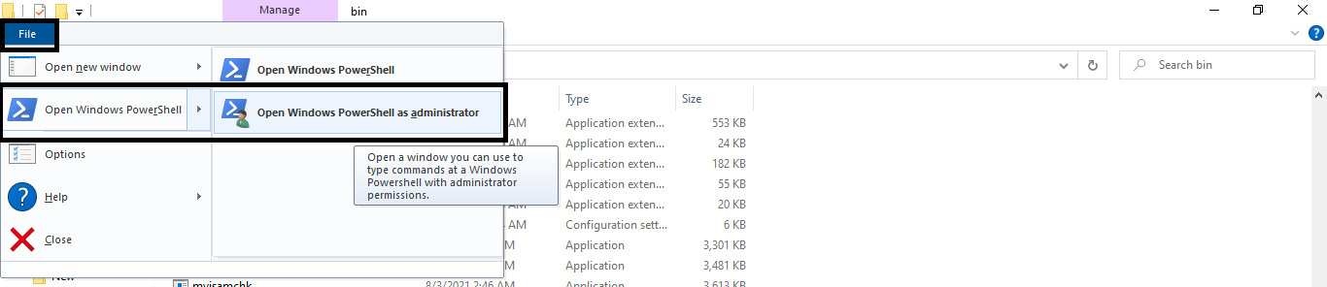
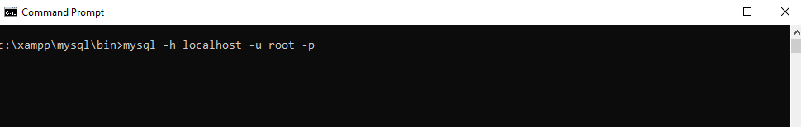
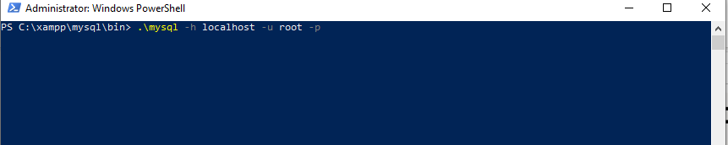
How to access MySQL

Slide 21
How to access MySQL
^{2nd method}
By using Command prompt on Different location
Default Installation location is : C:\xampp\mysql\bin
^{Start → Command Prompt}
^{Run below Code to access MySQL}
1st command :- cd C:\xampp\mysql\bin
2nd Command :- mysql -h localhost -u root –p
^{Command Format identification}
mysql –h hostname –u username –p [password]

Slide 22
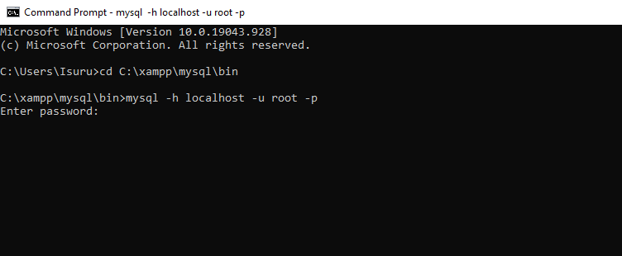
How to access MySQL

Slide 23
How to access MySQL
^{3rd method}
^{Via XAMMP interface}
^{Start → Xammp}
^{Click on Shell button}
Run command Command :- mysql -h localhost -u root –p

Slide 24
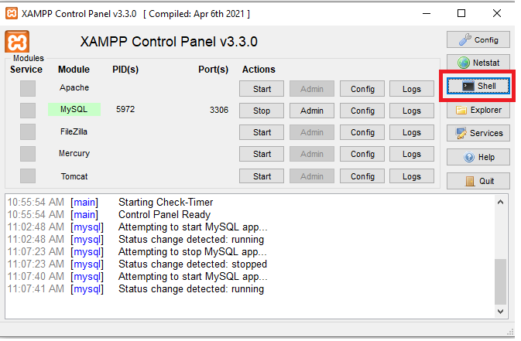
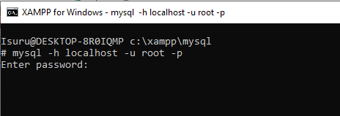
How to access MySQL

Slide 25
How to access MySQL

Slide 26

Try it by your self

